Slide 1
Overview of illegal memory modifications – Attacks and Defenses
Dennis Fischer
07.12.2015
Intermediate Bachelors Thesis Presentation
Supervisor: Prof. Dr. Alexander Pretschner Advisor: M. Sc. Sebastian Banescu

Slide 2
What is Process Memory Tampering (PMT)?
„Illegal modification of a process virtual memory by a malicious program“

Slide 3
What is Process Memory Tampering (PMT)?
„Illegal modification of a process virtual memory by a malicious program“

Slide 4
What is Process Memory Tampering (PMT)?
„Illegal modification of a process virtual memory by a malicious program“
Windows 7 has a total market share of ~50% ¹
Windows 8, 8.1 and 10 have only a combined one of ~30% ¹
Google Chrome has total market share of ~66%¹
Browser Hijackers use PMT

Slide 5
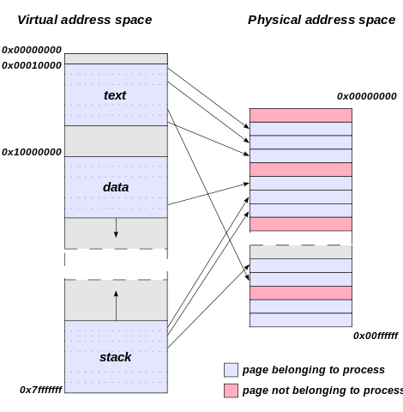
Virtual memory
Every process uses it‘s own address space
Used for code, data, text,… sections
Process can allocate memory
Process can modify memory
https://en.wikipedia.org/wiki/Virtual_address_space

Slide 6
Why is PMT interesting?
Attacker can modify virtual memory with normal user privileges
Examples:
Intercept/Redirect function calls
Hijacking of applications (for example browsers)
Read (secret) information from memory (SSL Shared keys, Userdata,…)
Change values in memory
Cheats modify the virtual memory
Common online cheats:
Aimbots
Wallhacks
„Scripts“

Slide 7
How can virtual memory get accessed?
Attack from outside (External Modification):
Attack from inside (Internal Modification):
Process A
Write into memory
Process B
Process A
Write into memory
Process A

Slide 8
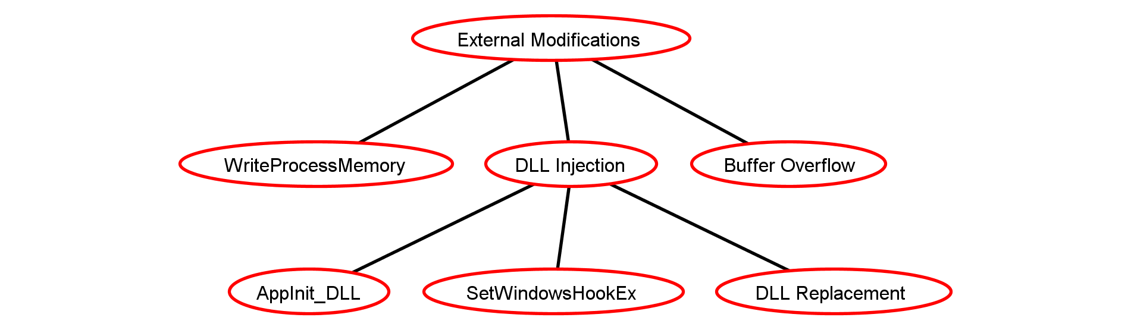
External Attacks
Legend
Attack
Countermeasure
Many ways
Currently only identified by antivirus with hashvalue
Most used
Write into virtual memory
Typically always possible (Debug function)
Example: Heartbleed bug
Bug in OpenSSL library
No additional code executed, but sensitive information revealed

Slide 9
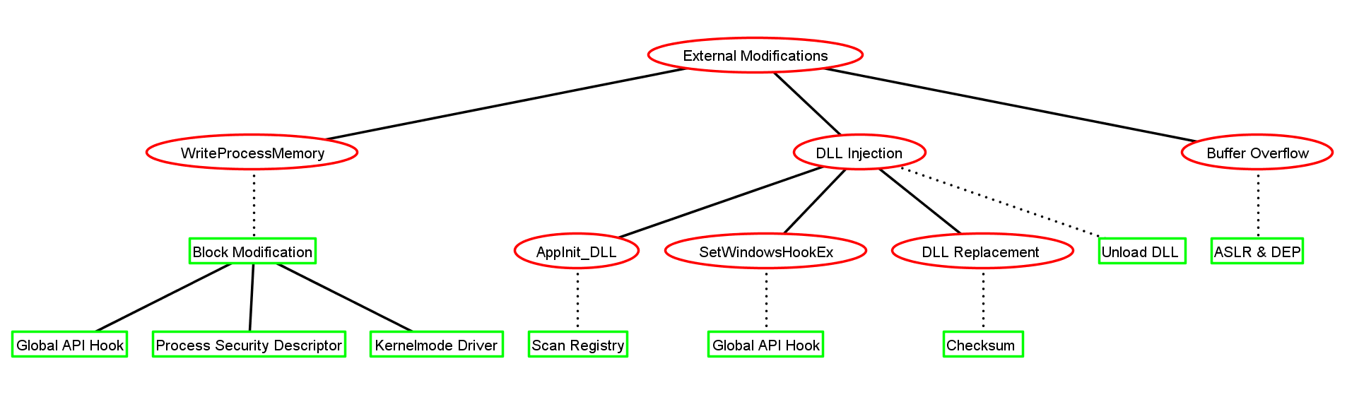
External Attacks – Countermeasures
Legend
Attack
AppInit_DLL uses registry key
Scan if key is used
SetWindowsHookEx prevent with Global API Hook
DLL Replacement require valid checksum
What is a good / bad DLL file?
Global API Hook:
Attach to all processes
Hook WriteProcessMemory & Deny access
Buffer Overflows are hard to detect
Already existing techniques (ALSR & DEP) help preventing attacks
Process Security Descriptor:
Uses Windows DACL
Denies access
Problem with Chrome:
Uses inter process communication with WriteProcessMemory
→ Chrome malfunctions
Kernelmode Driver:
Gets called on „OpenProcess“ call
Removes virtual memory write permissions
E.g.: DesiredAccess &= ~(PROCESS_VM_WRITE);
Countermeasure

Slide 10
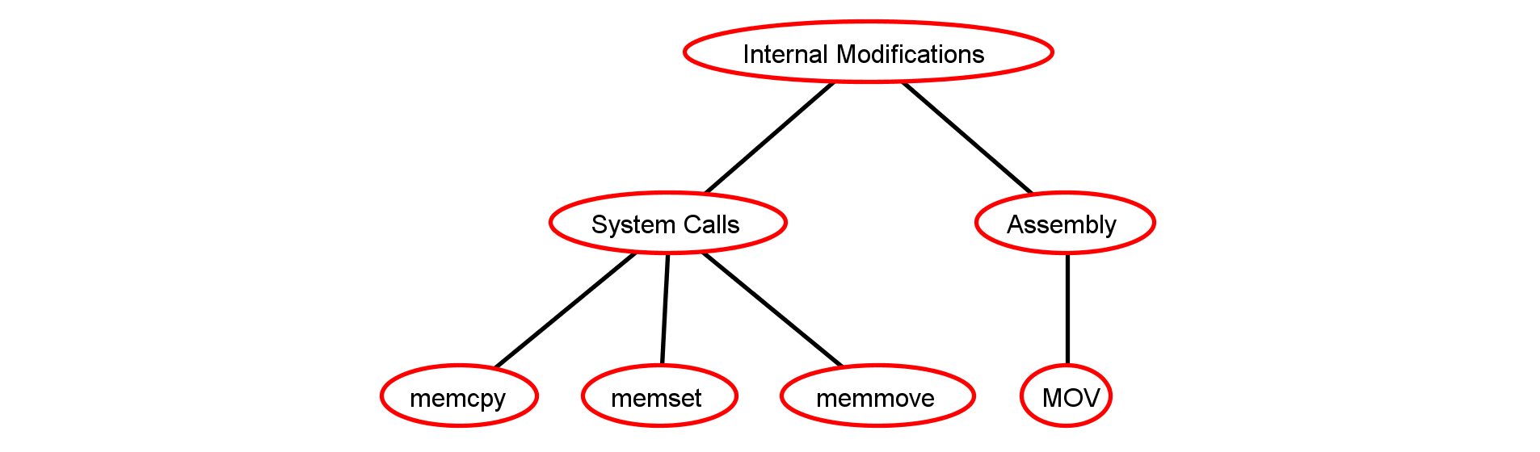
Internal Attacks
Legend
Attack
Countermeasure
Attacker can use assembly instructions like MOV to modify memory
Attacker can use existing system calls to modify memory

Slide 11
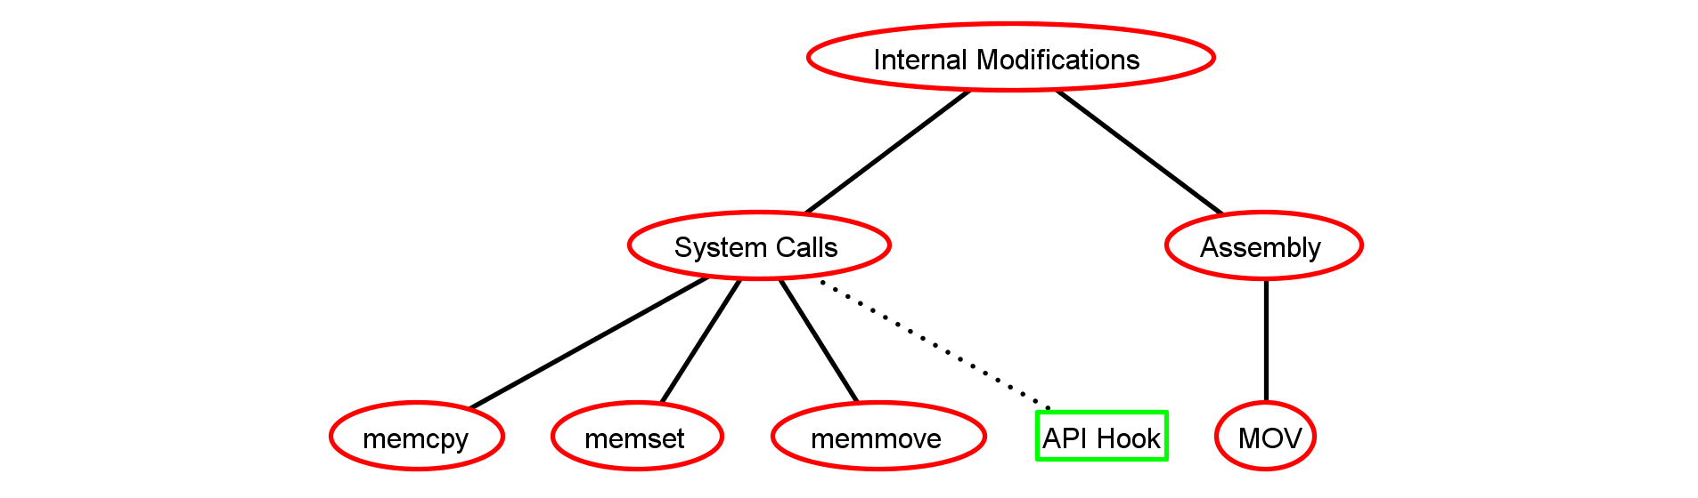
Internal Attacks – Countermeasures
Legend
Attack
Countermeasure
What is a good / bad MOV instruction?
Can address validation be done?!
As of now: No countermeasures
Use API Hook
Detect unwanted memory changes:
Do address validation
Prevent code changes

Slide 12
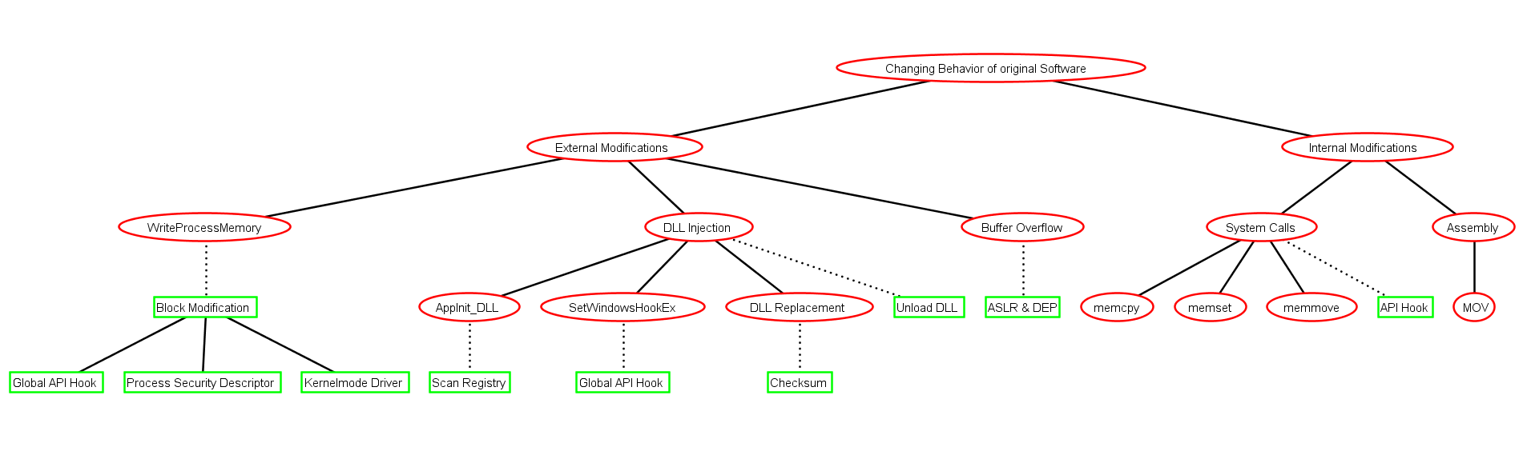
Putting it together
Legend
Attack
Countermeasure

Slide 13
What of these defenses are currently existing?
Basically nothing! Why?
Existing techniques like ASLR, DEP and MIC don‘t help (See next slides)
Kernelmode attacks cannot be blocked!
Only few research done in this area.
Commercial solutions are closed source (e.g. Anti-Cheats, Antivirus)

Slide 14
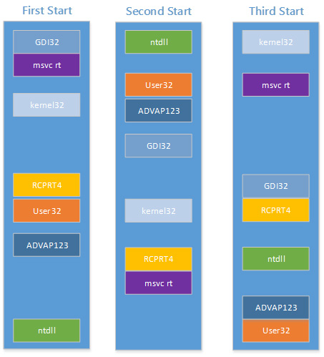
Address Space Layout Randomization (ASLR)
Randomize location of heap, stack, PEB, TEB,
Attacker has to guess memory locations
Searching is hard! (32bit → 4 GB, 64bit → 8 TB)
Wrong guess → Application crashes
BUT:
Attacker has time to search
API Hooking requires no search (GetProcAddress)
https://technet.microsoft.com/en-us/library/dn283963.aspx

Slide 15
Data Execution Prevention (DEP)
Memory pages are set to „No execute“ (NX bit) in hardware
Executing code from NX marked page
→ Application crashes
BUT:
Unset NX bit with VirtualProtectEx
Every process contains at least one page without set NX bit

Slide 16
Mandatory Integrity Control (MIC)
Based on Multilevel Security and Bell-LaPadula model
BUT:
Most processes run with Standard(Medium) integrity level → No protection from memory modification
Raising integrity level of Chrome to high is bad → Grants more access rights to successful attacker
Integrity Levels
System
High
Medium
Low

Slide 17
Thesis Goals
Find a way to detect illegal virtual memory modifications inside Google Chrome
If possible, prevent modifications / hijacking
Limit to Usermode
Challenges:
Attacks from inside and outside possible
Detection proves to be difficult
Almost no existing research
Some countermeasures currently just ideas and part of further research in the thesis „Detecting Process Memory Tampering“

Slide 18
Timeline
15.10.2015
Start of thesis
15.11.2015
15.12.2015
15.01.2016
15.02.2016 End of thesis
Writing
Initial research Literature study
Design & Implementation

